Slide 1
Secretary’s Report
North American Division
2025 Year End Meetings
Presented by Kyoshin Ahn

Slide 2
Secretariat
Secretariat
Human Relations
eAdventist Membership Ministries
Volunteer Ministries
Human Resource Services
Archives, Statistics & Research
Missionary Services
Professional Services

Slide 3
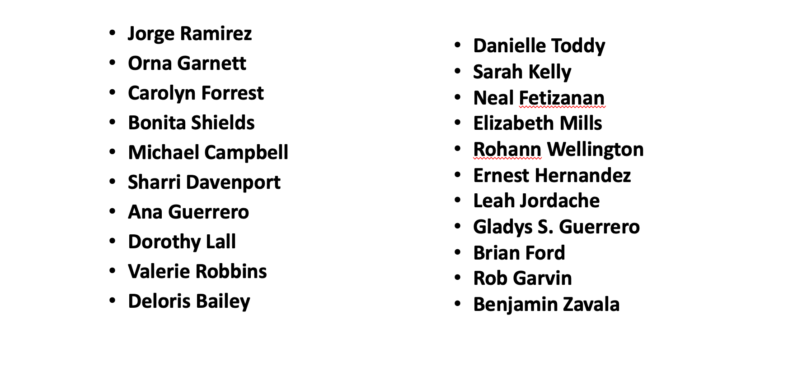

Debt of Gratitude to My Staff

Slide 4
Membership 2025
GREAT NEWS!!!!
NAD Just Reached
1,306,533
(Membership as of 3rd Quarter 2025)

Slide 5
NAD Membership 1867-2025
Year Membership
1867 4,320
1907 58,557
1947 228,179
1985 669,587
2020 1,265,754
2025 (3rd qtrs) 1,306,533

Slide 6
NAD Membership (2025-2025)

Slide 7
NAD Beginning/Ending Membership 2015-2025

Slide 8
Baptisms 2015-2025

Slide 9
Profession of Faith 2015-2025

Slide 10
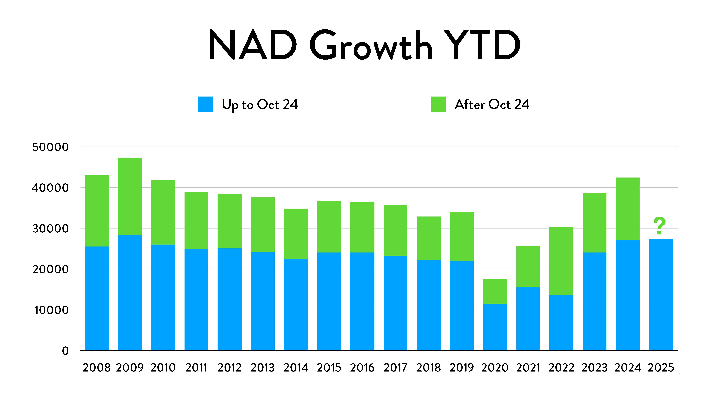

Slide 11
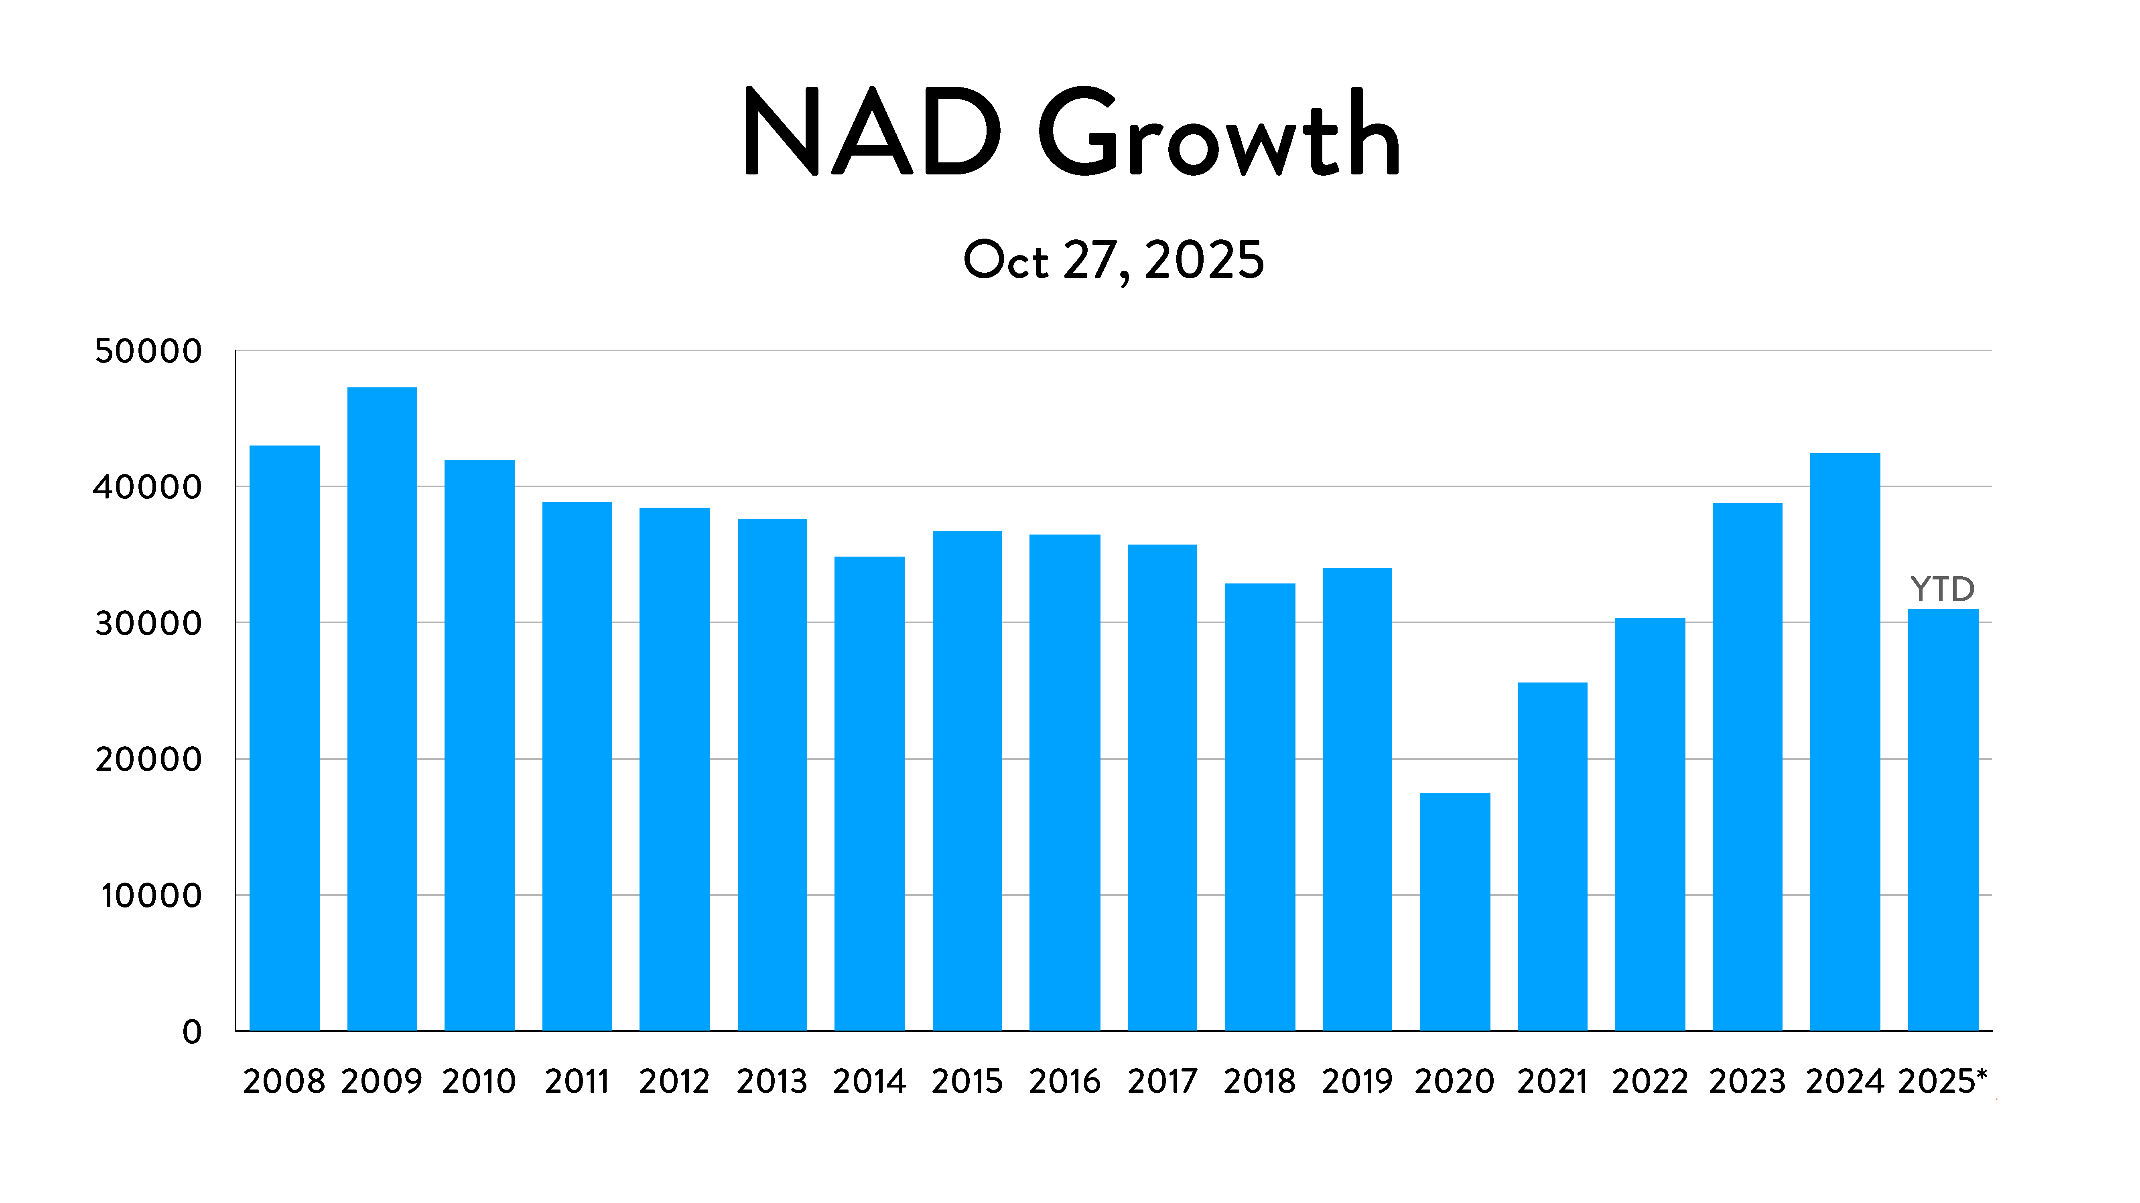

Slide 13

Membership Transfers In and Out

Slide 14
Transfers In & Out 2015-2025
1,158

Slide 15
NAD Gender 2024

Slide 16
NAD Age Breakdown of Members

Slide 18
NAD Membership vs. World Membership 2024

Slide 19

NAD Congregations 2025 (3rd Quarter)
5,807 Churches
894 Companies

Slide 20
Churches and Companies

Slide 21

Attrition and Losses

Slide 22
Deaths 2014-2024

Slide 23
NAD Deaths, Dropped, and Missing 2014-2025

Slide 24
Accession Rate
Additions by baptism and faith for every 100 members at the

Slide 25
NAD Accession Rate 2014-2024

Slide 26
Rate of Net Growth
The changes in membership between the beginning of the year and the end of the year, shown as percentages

Slide 28
A State of our Churches in North America
1985-2025

Slide 29
“You shall remember the whole way the Lord your God has led you these forty years in the wildness”
(Deut 8:2, NIV)

Slide 30
Intertwined History

Slide 31
Our modern history is a passionate continuation of the Adventist movement that began in the 19th century, and a faithful response to its ethos in modern context.

Slide 32
Splendid isolation in history doesn’t exist in the Adventist church.

Slide 33
Washington Seventh-day Adventist Church in New Hampshire

Slide 34
Why 1985?

Slide 35
Local Churches and Membership 1985-2025
Membership Trend
Membership Statistics Analyzed
Pastors and Church Schools and Teachers

Slide 36
Mission to the World

Slide 37
Mission to the World
Missionary Outreach to the World
Volunteer Serving the world
Student Volunteer Movement
Current Status of Volunteers

Slide 38
Financial Resources and Growth 1985-2025

Slide 39
Financial Resources and Growth, 1985-2025
Tithe: The Last 40 years
Harvest Ingathering / Mission Offerings
NAD Tithe Contribution to the worldwide works of GC
Current Tithe Distribution Model

Slide 40
“In reviewing our past history, … I am filled with astonishment and with confidence in Christ as Leader. We have nothing to fear for the future, except as we shall forget the way the Lord has led us, and His teaching in our past history. We have everything to be thankful for” (3SM 162)
(Luke 12:48)

Slide 43
Define our future

