Slide 1

That Magic Moment
Michael W. Campbell, Ph.D.
Director of NAD Archives, Statistics, and Research.
Notes:
https://documents.adventistarchives.org/Periodicals/YI/YI19000308-V48-10.pdf
https://commons.wikimedia.org/wiki/File:Diamond_Head,_Waikiki_Beach,_and_Helumoa..._by_Charles_Furneaux.jpg

Slide 2
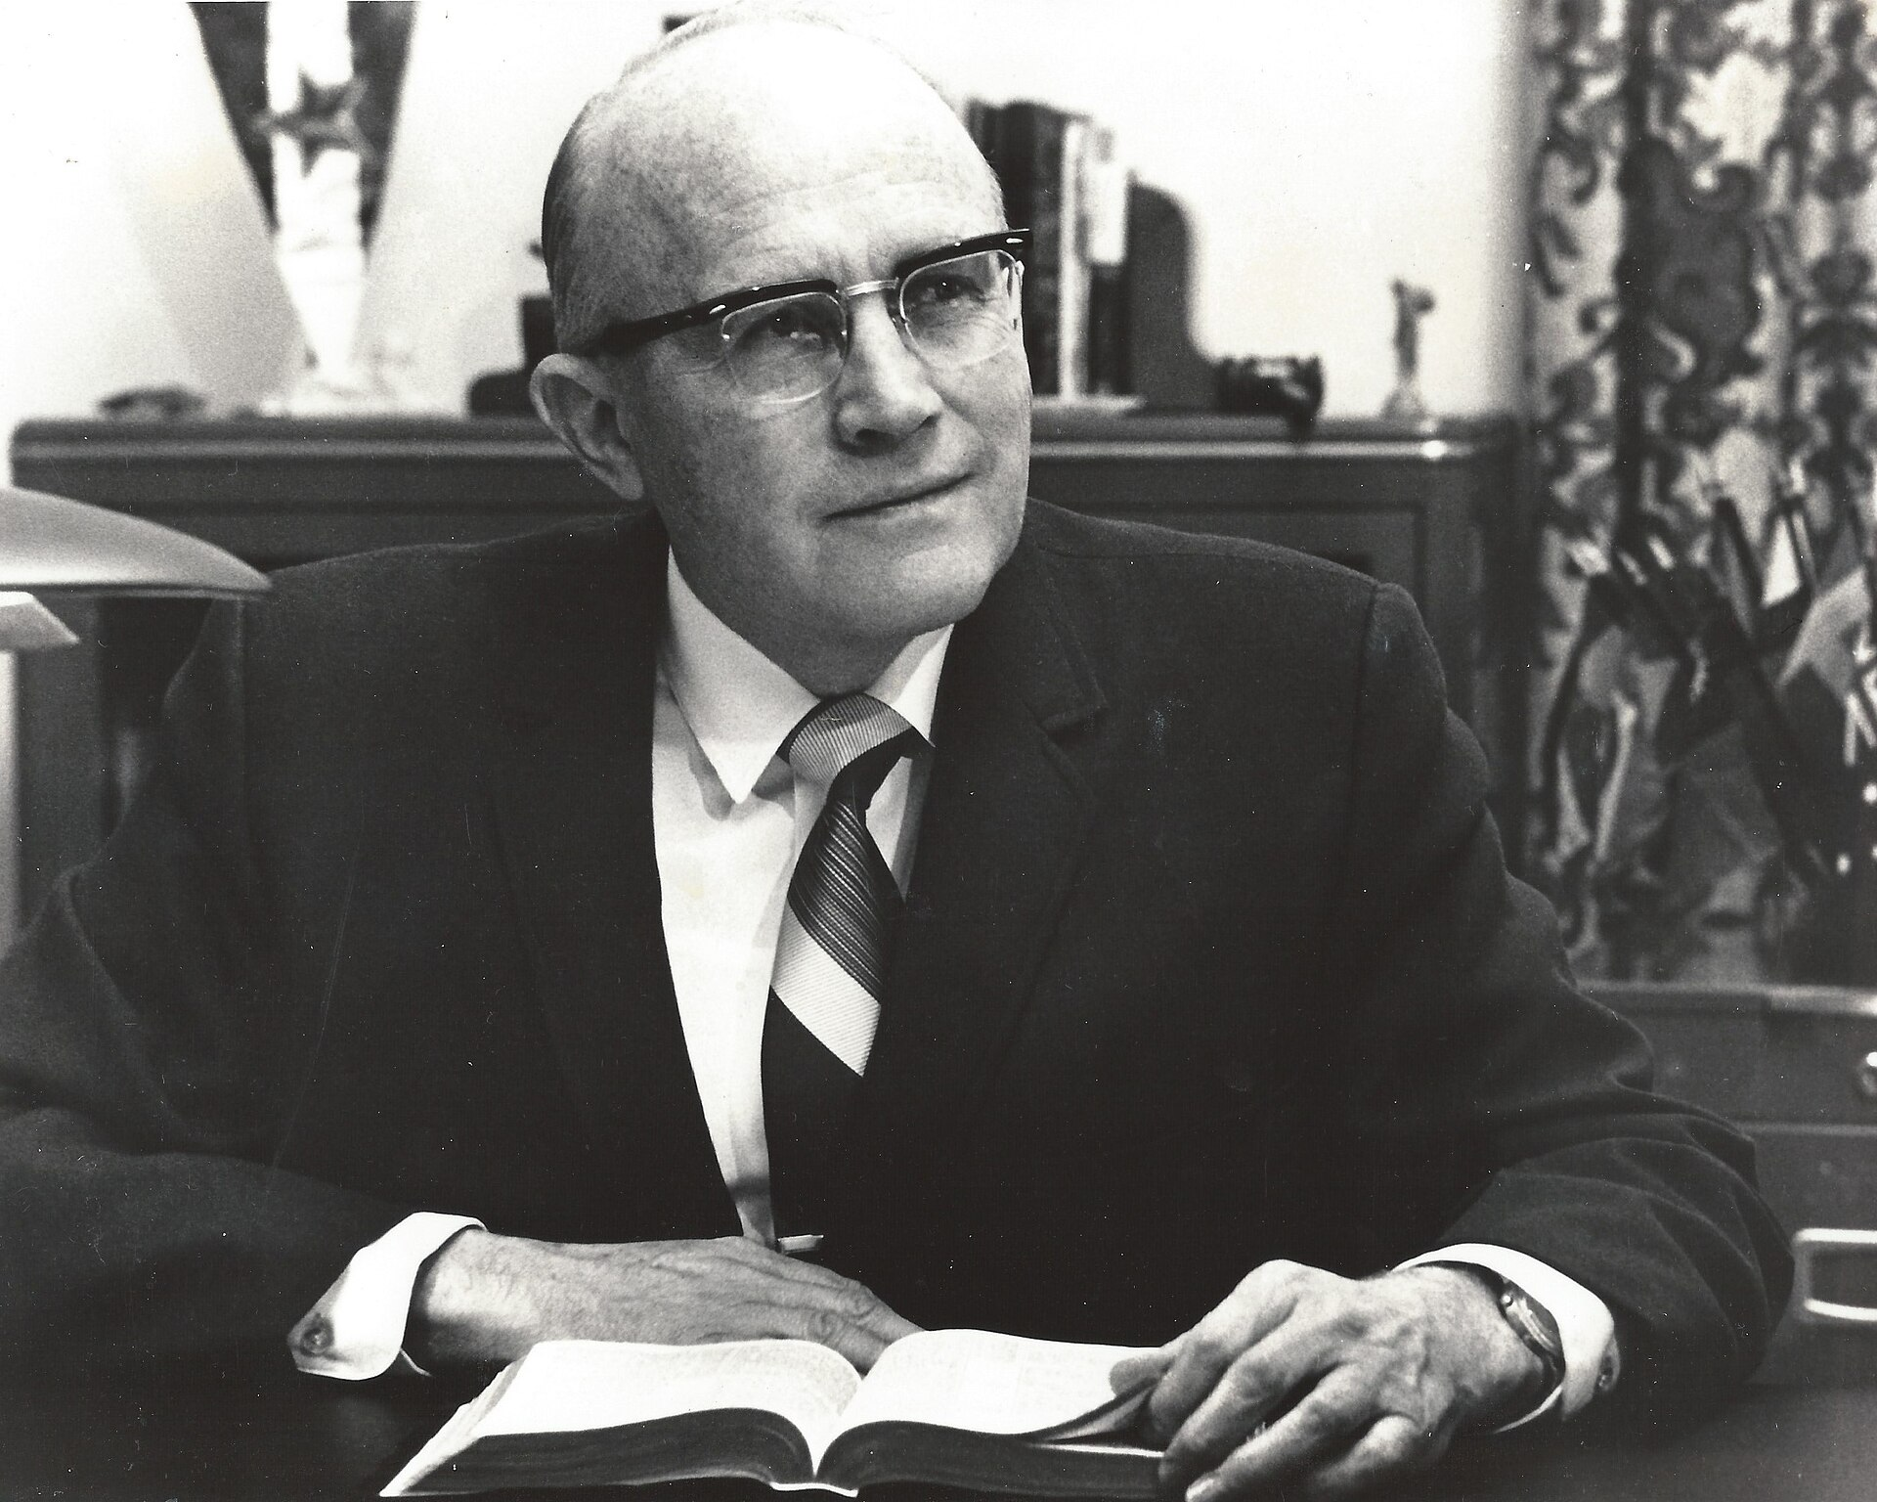
Notes:
The increased power of the General Conference president meant that in the late 1970s, first under Robert H. Pearson, and then later under Neal C. Wilson (vice-president for North America under Pearson) who subsequently became General Conference president (1979-1990) that the denomination would re-evaluate its administrative structure. Effectively toward to the end of Pearson’s tenure the church president gained veto power in the selection of division presidents. Once Wilson became church president, Charles Bradford was elected as vice-president for North America to replace him. Bradford assumed leadership serving as chair of the NAD Committee on administration beginning on July 5, 1979.

Slide 3
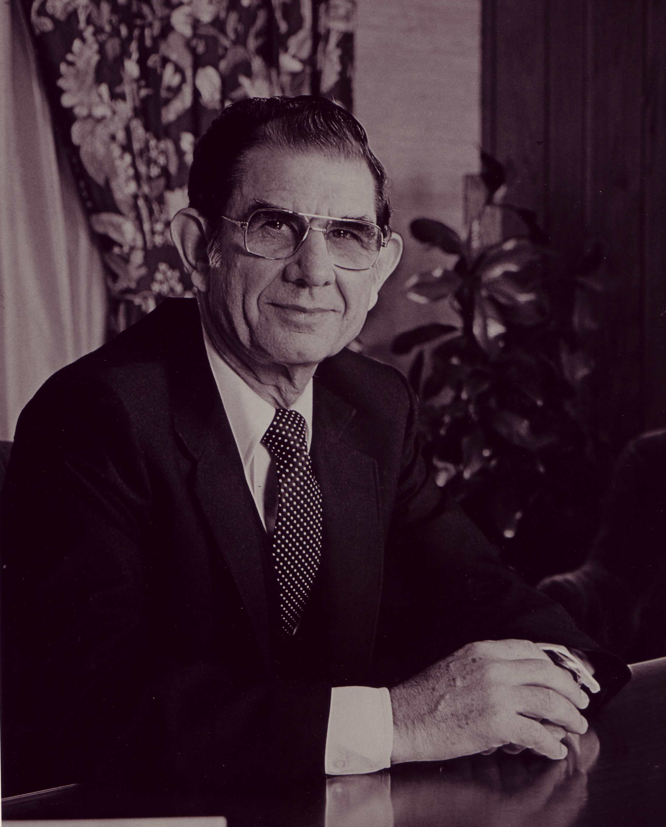
Notes:
https://adventistmessenger.ca/wp-content/uploads/2010/12/NealWilson.jpg

Slide 4
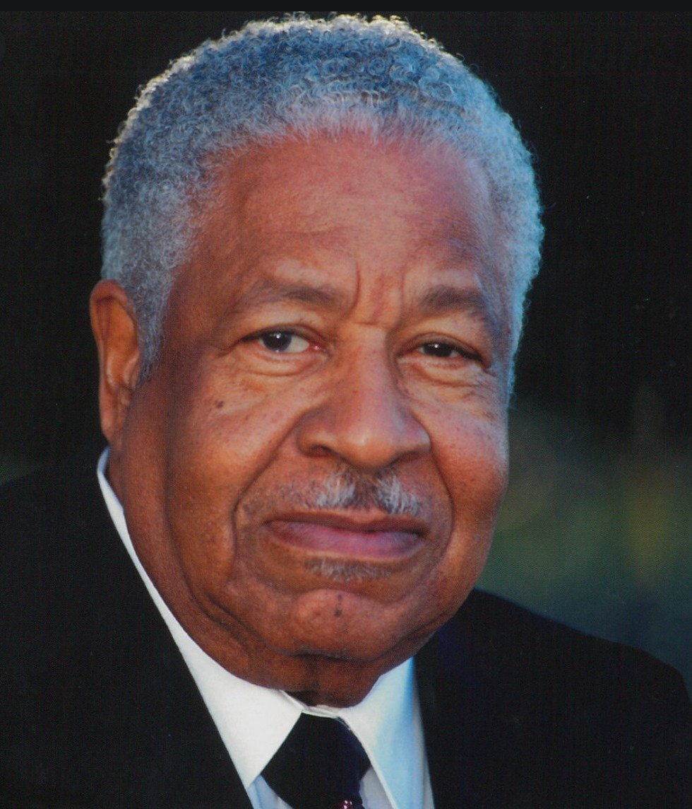
Notes:
Bradford’s election in 1979 to the top leadership in the NAD, less than 15 years after the denomination decisively renounced segregation, was widely-hailed as a milestone in denominational race relations not only within the church but also in the public media, including the New York Times and the Washington Post. A feature article in Ebony magazine reported that Bradford had been elected “president of all Adventists in North America, becoming the first Black to attain that position.”
Though frequently referred to as “president,” Bradford was in fact elected to the position of GC vice president for the NAD. The distinction is important because it was indicative of a longstanding “special relationship” that enmeshed the NAD with the GC in the denomination’s governance structure. It was a relationship that was causing considerable discontent in North America by the 1970s, and one of the top priorities of Bradford’s administration was to move the NAD toward becoming a full-fledged division comparable to the other divisions of the General Conference.
“‘Second Coming of Christ is Near,’” Ebony, November 1979, 107. See also George Vecsey, “7th Day Adventists Elect Black Chief,” New York Times, January 12, 1979, A20; Marjorie Hyer, “Seventh-Day Adventists Elect a Black President,” Washington Post, January 13, 1979, accessed October 10, 2024, https://www.washingtonpost.com/archive/politics/1979/01/13/seventh-day-adventists-elect-a-black-president/f70df9f9-139e-4174-a2f9-ec32763cc9e3/.

Slide 5
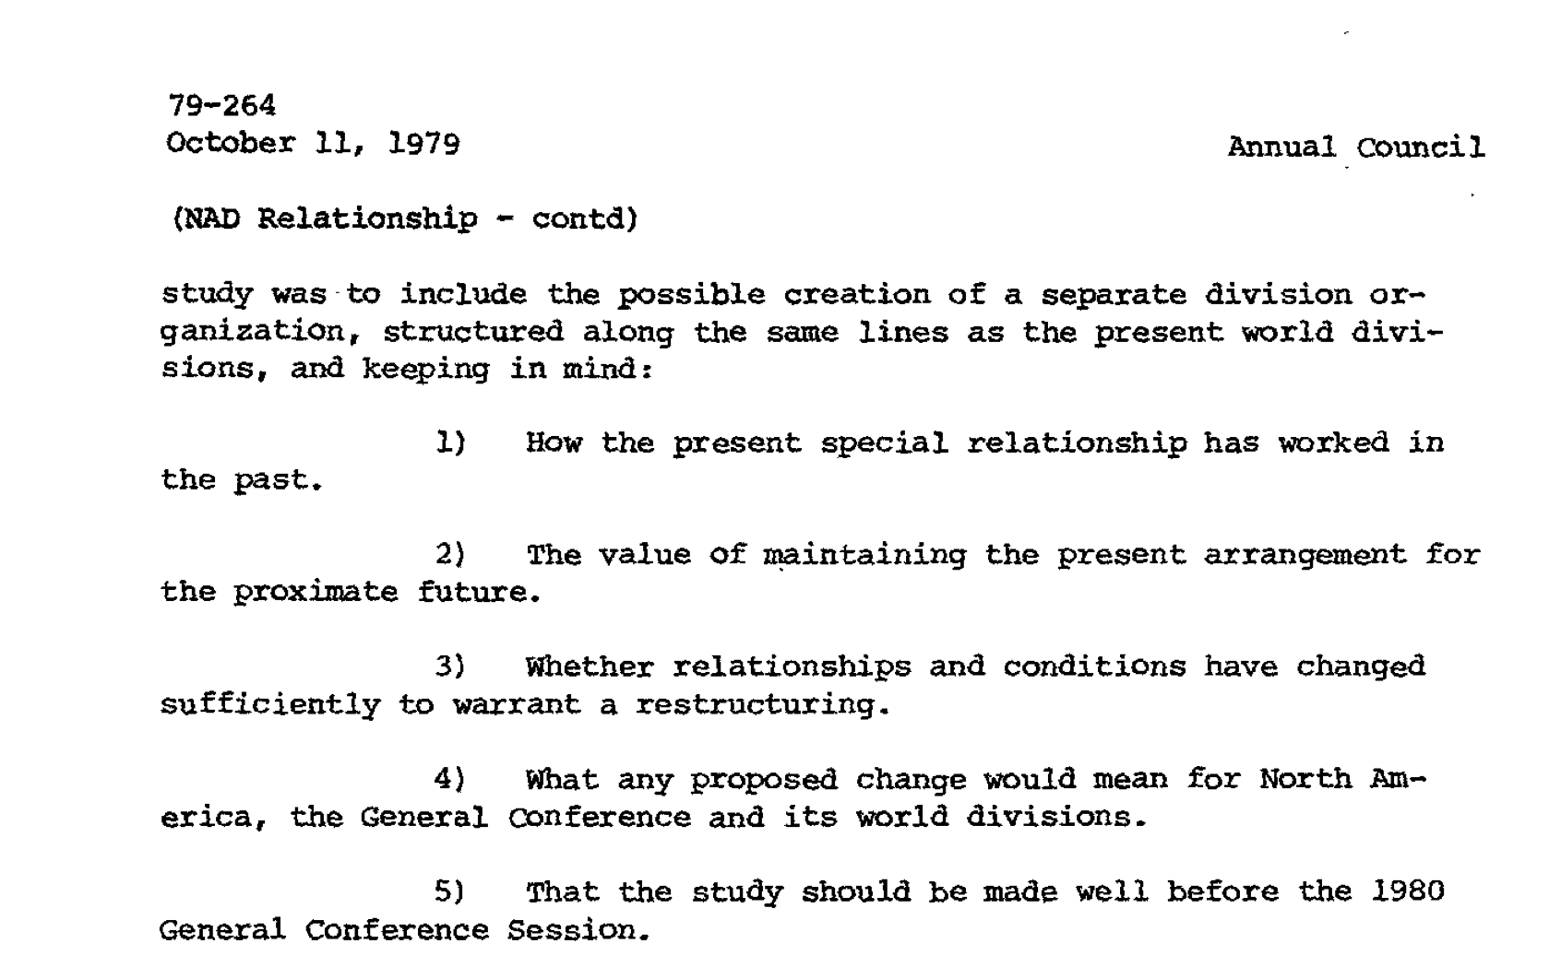
Notes:
https://documents.adventistarchives.org/Minutes/GCC/GCC1979-10a.pdf#search=%22continue%20to%20study%20changes%20in%20the%20present%20relationship%20%22
The North American Division, by contrast, was administered directly from General Conference headquarters in Washington, DC. Its only administrative apparatus was the NAD Committee on Administration, established in 1950. Though the vice president for the NAD was sometimes informally or for convenience’ sake referred to as the division president, even in denominational publications, he did not formally hold that title. Thus, unlike the other world divisions, the NAD had no president, no officially designated officers or departmental leaders, no office space, and no budget. With the other divisions rapidly growing in size and influence, conviction grew among North American leaders that the historic intertwining of the GC and NAD was inhibiting rather than aiding the church’s mission in their territory. An NAD with a profile and structure more akin to that of the other divisions was urgently needed, they believed, to enable development of strategies and policies that would more effectively implement the shared mission of the world church in North America.
See for example the cover of the Review and Herald, July 10, 1975.

Slide 6
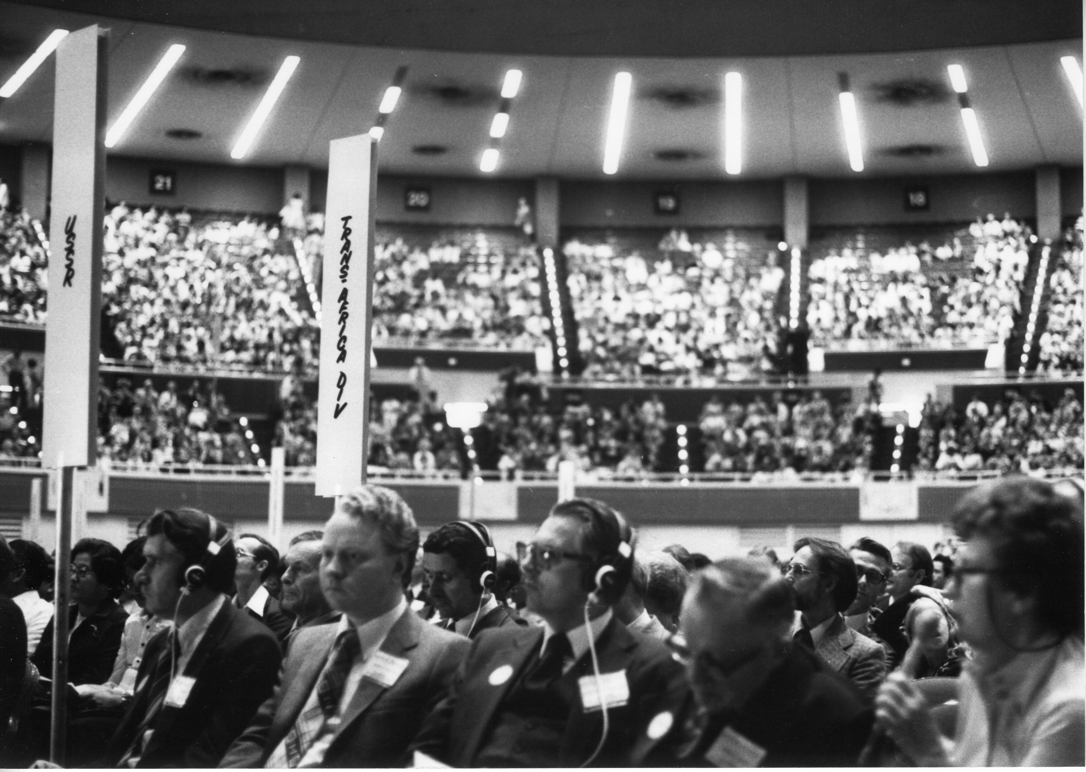
Notes:
At its April 1980 session in Dallas, Texas, the General Conference elected Bradford to continue as vice president for the NAD. Though his title was unchanged, leaving the NAD without a president, the session voted a seemingly minor change in policy that in fact represented a significant step forward for the division. It authorized the North American members of the GC nominating committee, rather than the committee as a whole, to nominate a slate of officers and departmental directors for assignment to the NAD. Going forward, this change meant that Elder Bradford would be authorized to convene meetings with NAD personnel to develop plans and exercise leadership for the church in North America.
“Where is the North American Division Going?,” Ministry, April 1984, 14-15.

Slide 7
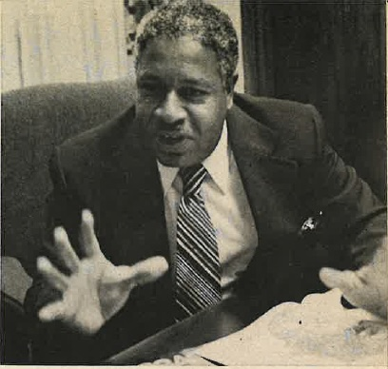
Notes:
Bradford’s sermon on the first Sabbath (April 19) of the 10-day session, “Formula for Change,” drew on the biblical prophets in setting the tone and direction for his administration. “God’s formula for change,” Bradford declared, “is to break up the dull, tame, monotony of our religious labor and to take on a deep, earnest, sanctified zeal.” He broadened the typical understanding of Adventist mission by invoking the prophetic mandates of justice and compassion: “The principles of justice and neighbor love must be worked out in the laboratory of human experience, in the here-and-now. And we are the ones to demonstrate these grand principles.” This would be a recurring theme in his sermons and articles.
To chart a path forward for mission in the NAD, Bradford embraced an endeavor, stemming from an evangelism Summit held at Glacier View Ranch in Colorado in April 1979, to formulate biblical leadership principles informed by up-to-date research on church growth and effective management models, and by listening to the perspectives of those on the ground in diverse ministry settings. The rubric adopted through this process, Faith Action Advance, called for empowering, and holding accountable, every unit of church organization for implementing plans best suited to reach their target populations. In all of this, attention was to be focused on the local church as the primary and most important unit of church organization. With the Caring Church model, voted in 1983, the NAD provided resources for renewal of dynamic local congregations in accordance with New Testament principles.
C.E. Bradford, “Formula for Change,” ARH, April 20, 1980, 13-14.
Lee and Sahlin, Brad: Visionary Spiritual Leadership, 84-87; “Bradford on Evangelism,” Ministry, April 1982, 8-9; C.E. Bradford, “When You Care Enough!,” Ministry, June 1983, 16-17; Myron K. Widmer, “Charles Bradford on the Church,” AHR, September 1, 1988, 8.

Slide 8
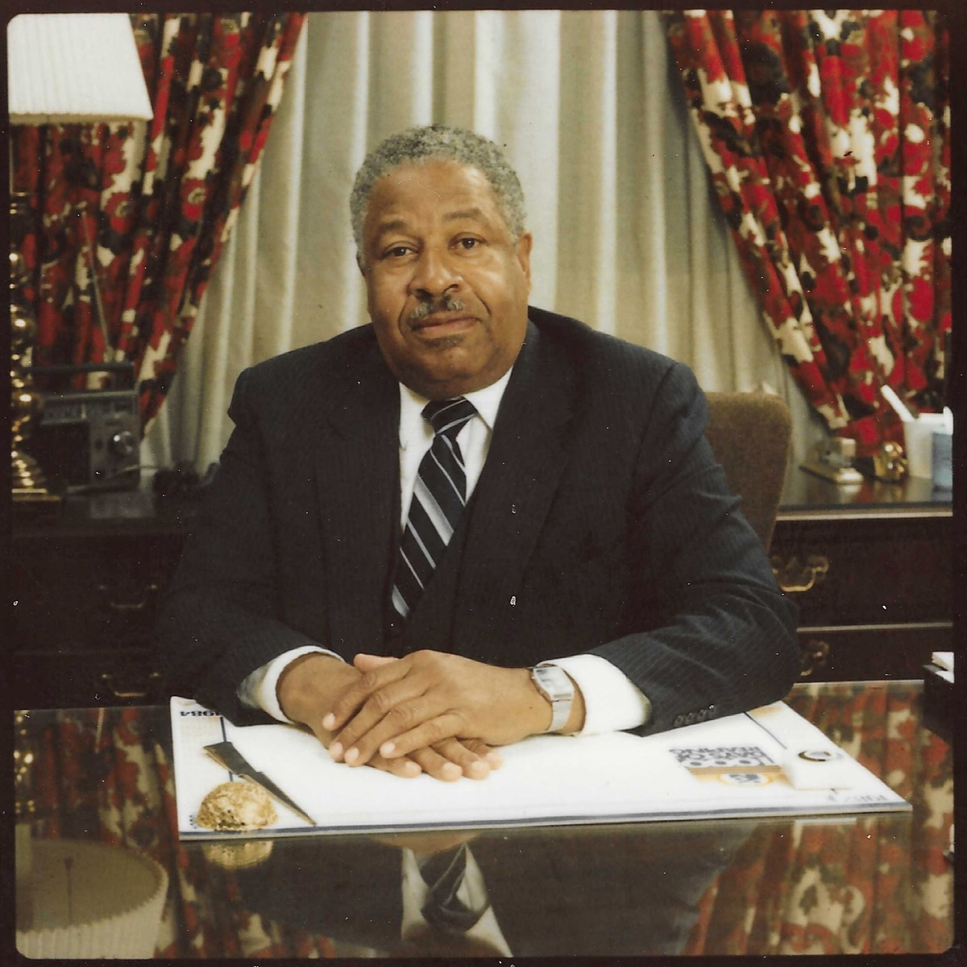
Notes:
To chart a path forward for mission in the NAD, Bradford embraced an endeavor, stemming from an evangelism Summit held at Glacier View Ranch in Colorado in April 1979, to formulate biblical leadership principles informed by up-to-date research on church growth and effective management models, and by listening to the perspectives of those on the ground in diverse ministry settings. The rubric adopted through this process, Faith Action Advance, called for empowering, and holding accountable, every unit of church organization for implementing plans best suited to reach their target populations. In all of this, attention was to be focused on the local church as the primary and most important unit of church organization. With the Caring Church model, voted in 1983, the NAD provided resources for renewal of dynamic local congregations in accordance with New Testament principles.
While the degree of receptivity varied from place to place, Faith Action Advance and the Caring Church helped give the NAD a distinct identity separate from the GC. Innovations introduced by the Bradford team to implement these formulas at the division level made a tangible impact on church life. The NAD affiliated with several “resource centers” such as the NAD Evangelism Institute, the HART Research Center, and the Center for Creative Ministry to make training and resources directly available to local ministries. Among the most enduring of these centers is AdventSource—a major publisher and distributor of local church leadership materials. The NAD also fostered development of a new Sabbath School resource, the Collegiate Quarterly, and organized an unprecedented division-wide Pathfinder camporee at Camp Hale, Colorado, in 1985. That event inaugurated the era of large-scale camporees every five years (international since 1994) that have become a prominent and highly-valued feature of Adventist life.
Lee and Sahlin, Brad: Visionary Spiritual Leadership, 84-87; “Bradford on Evangelism,” Ministry, April 1982, 8-9; C.E. Bradford, “When You Care Enough!,” Ministry, June 1983, 16-17; Myron K. Widmer, “Charles Bradford on the Church,” AHR, September 1, 1988, 8.
Lee and Sahlin, Brad: Visionary Spiritual Leadership, 103-104.
Leo S. Ranzolin, “Youth Department,” ARH, July 7, 1984, 3; Victory Kovach, “International Pathfinder Camporees,” Encyclopedia of Seventh-day Adventists, October 2, 2020, accessed October 8, 2024, https://encyclopedia.adventist.org/article?id=A9Y2.

Slide 9
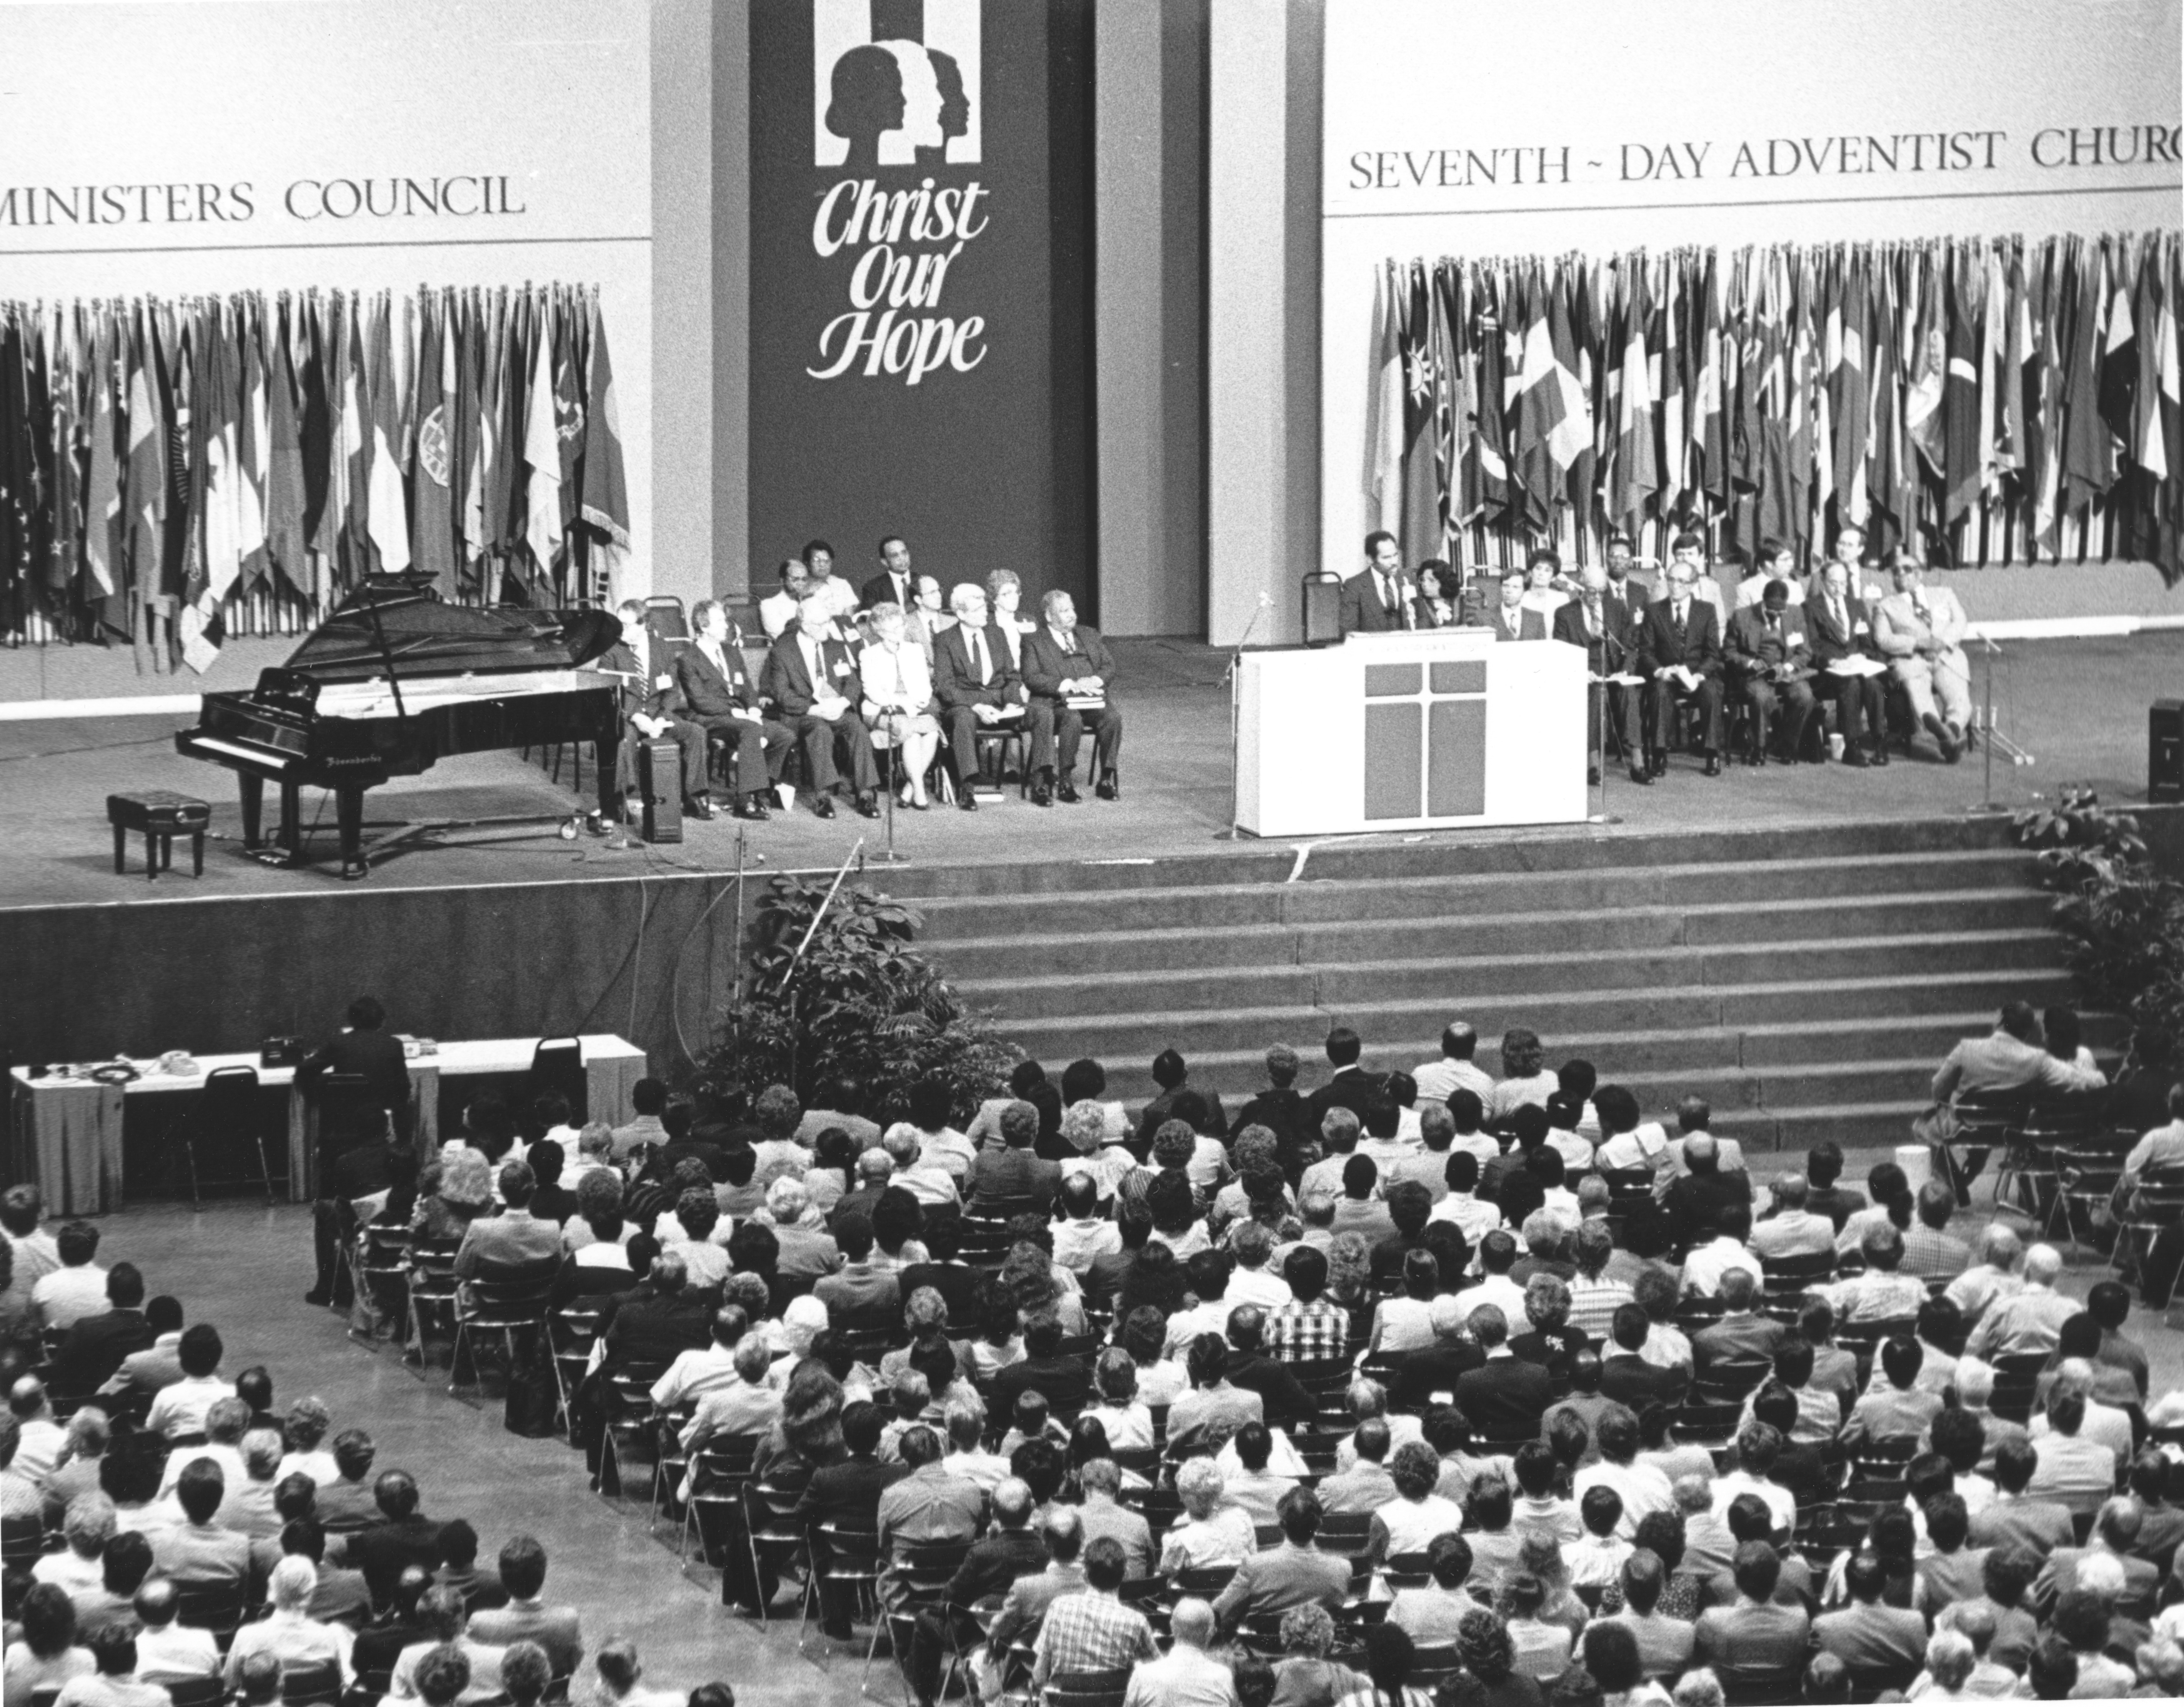
Notes:
On July 1, 1985, the General Conference voted to grant autonomy to create once again a separate North American Division. First the NAD Committee on Administration (NADCA) was reformulated once again as the NAD Committee (NADCOM). New terms of reference were developed that included new officers and a separate budget to handle their own finances. This would begin a process of creating an autonomous organization focused specifically on the mission of the denomination in North America. While it would take some time, slowly the NAD would make its own appointments, develop its own retirement plan, oversee Adventist Book Centers, and develop its own Higher Education Board.

Slide 10
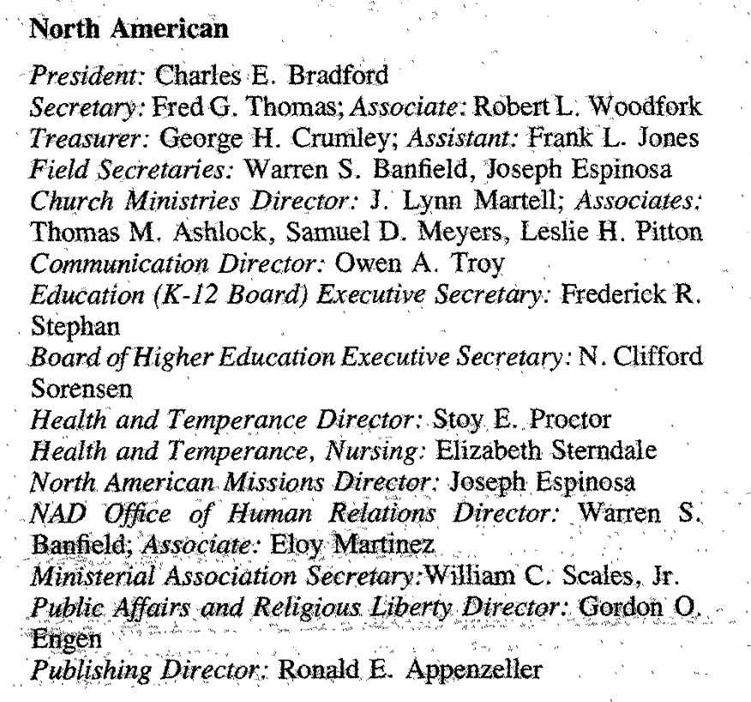
Notes:
For the first time the NAD had its own budget of $31 million (with most funds already earmarked).
Adopted as its first motto: “The Caring Church”

Slide 11
